Slide 1
Welcome
to
Pre cart
Submitted By-
1. Shuveccha Barua (1830107)
2. Masudul Alam (1830067)
3. Md. Mamunur Rashid (1830066)

Slide 2
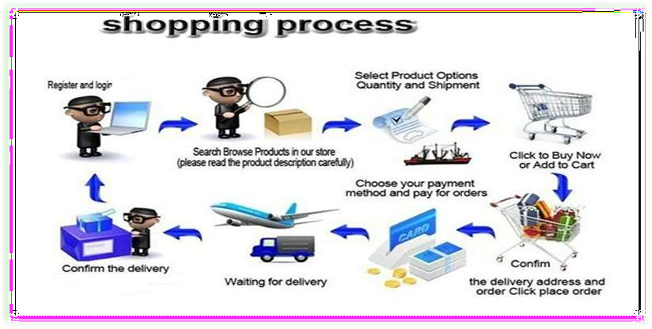
Process of online shopping:
A consumer uses Web browser to connect to the home page of a merchant's Web site on the Internet.

Slide 3
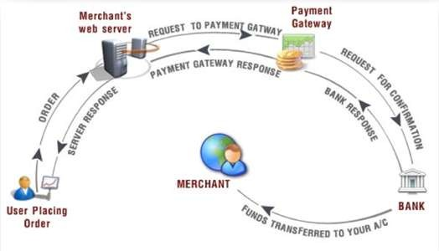
Payment gateway:

Slide 4


Modules
◆ The Admin can login the System
◆ Admin can create categories
◆ Admin can create subcategories
◆ Admin can upload products
◆ Admin can upload product features
◆ The buyers can login the System
◆ The buyers can search for a particular
product.
◆ The buyers can order a product.

Slide 5
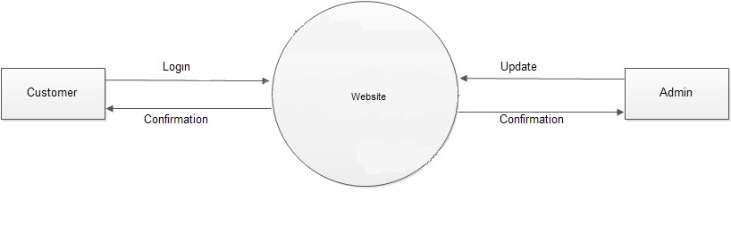
Data flow diagrams
◆ Dfd for level 0

Slide 6
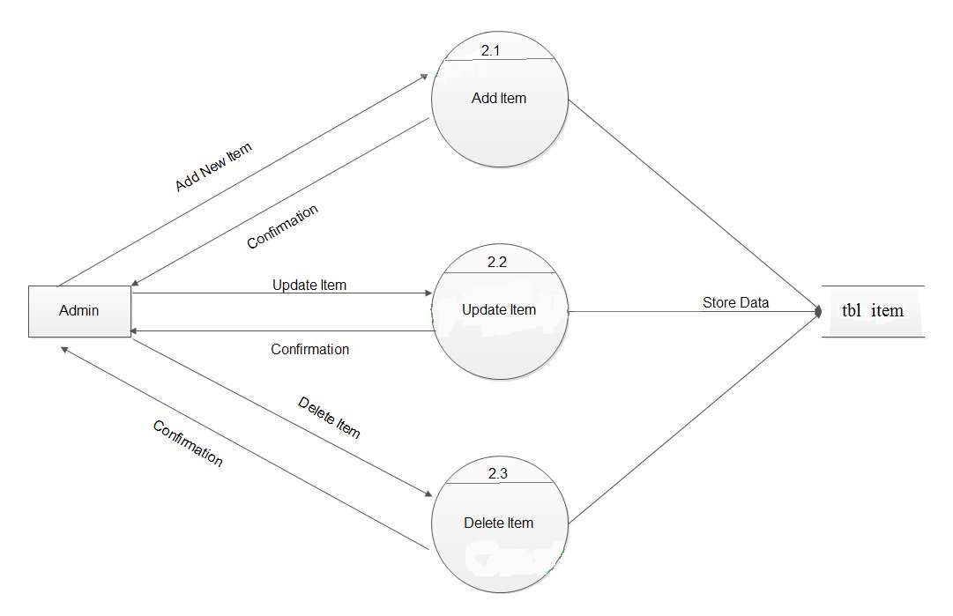
Dfd for admin

Slide 7
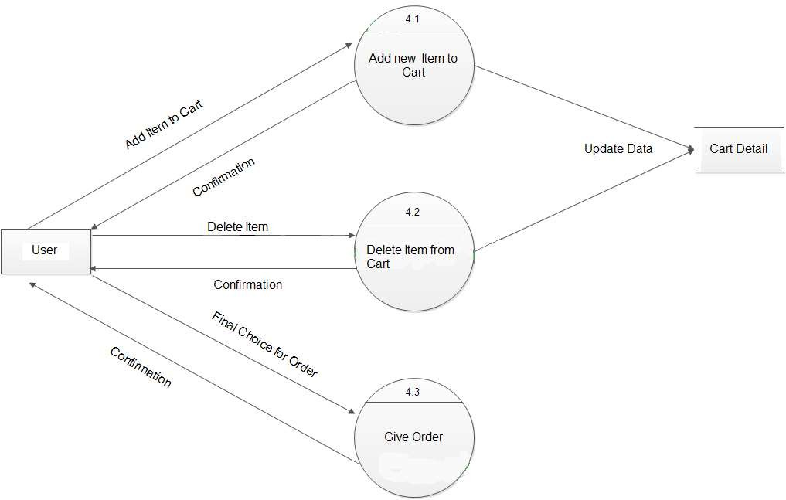
Dfd for User

Slide 8
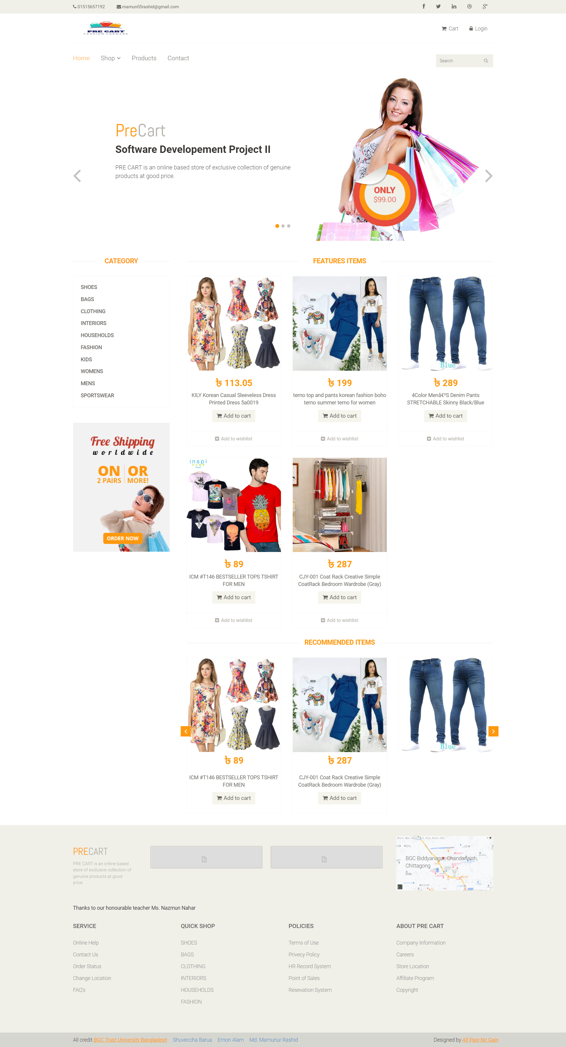

Slide 9
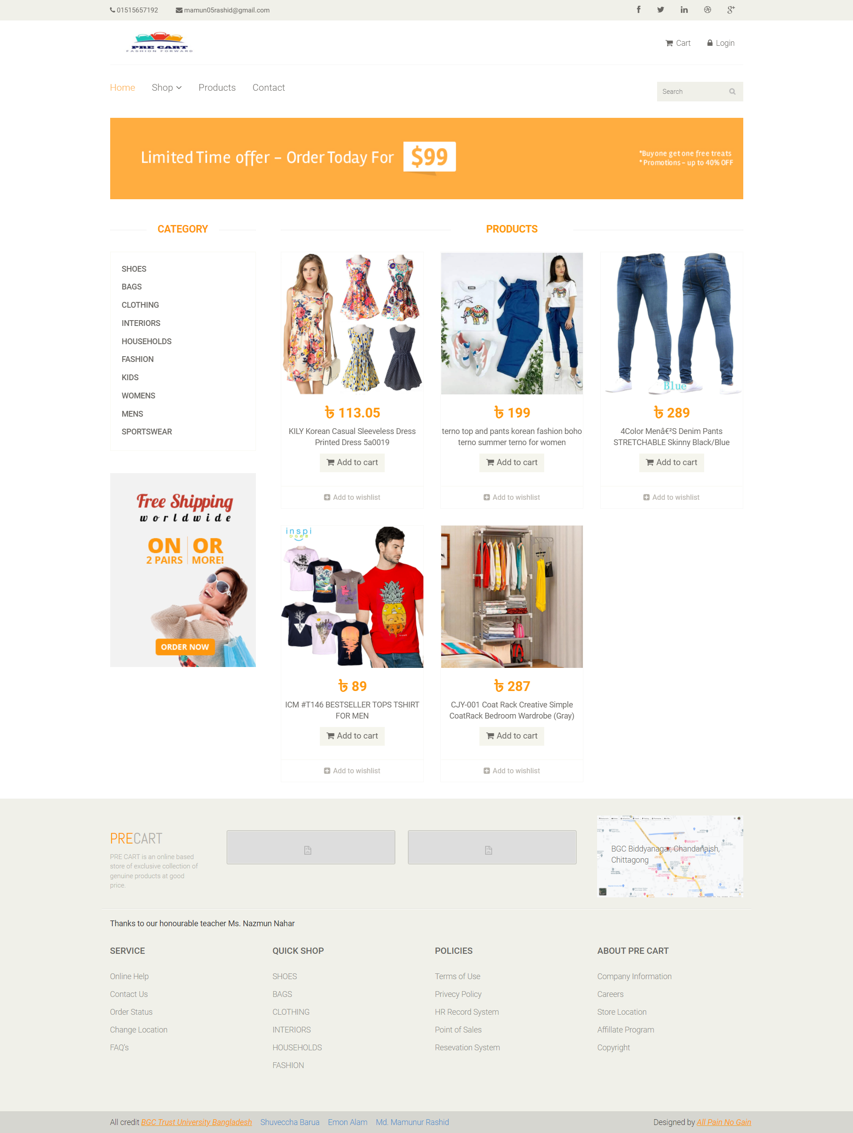

Slide 10
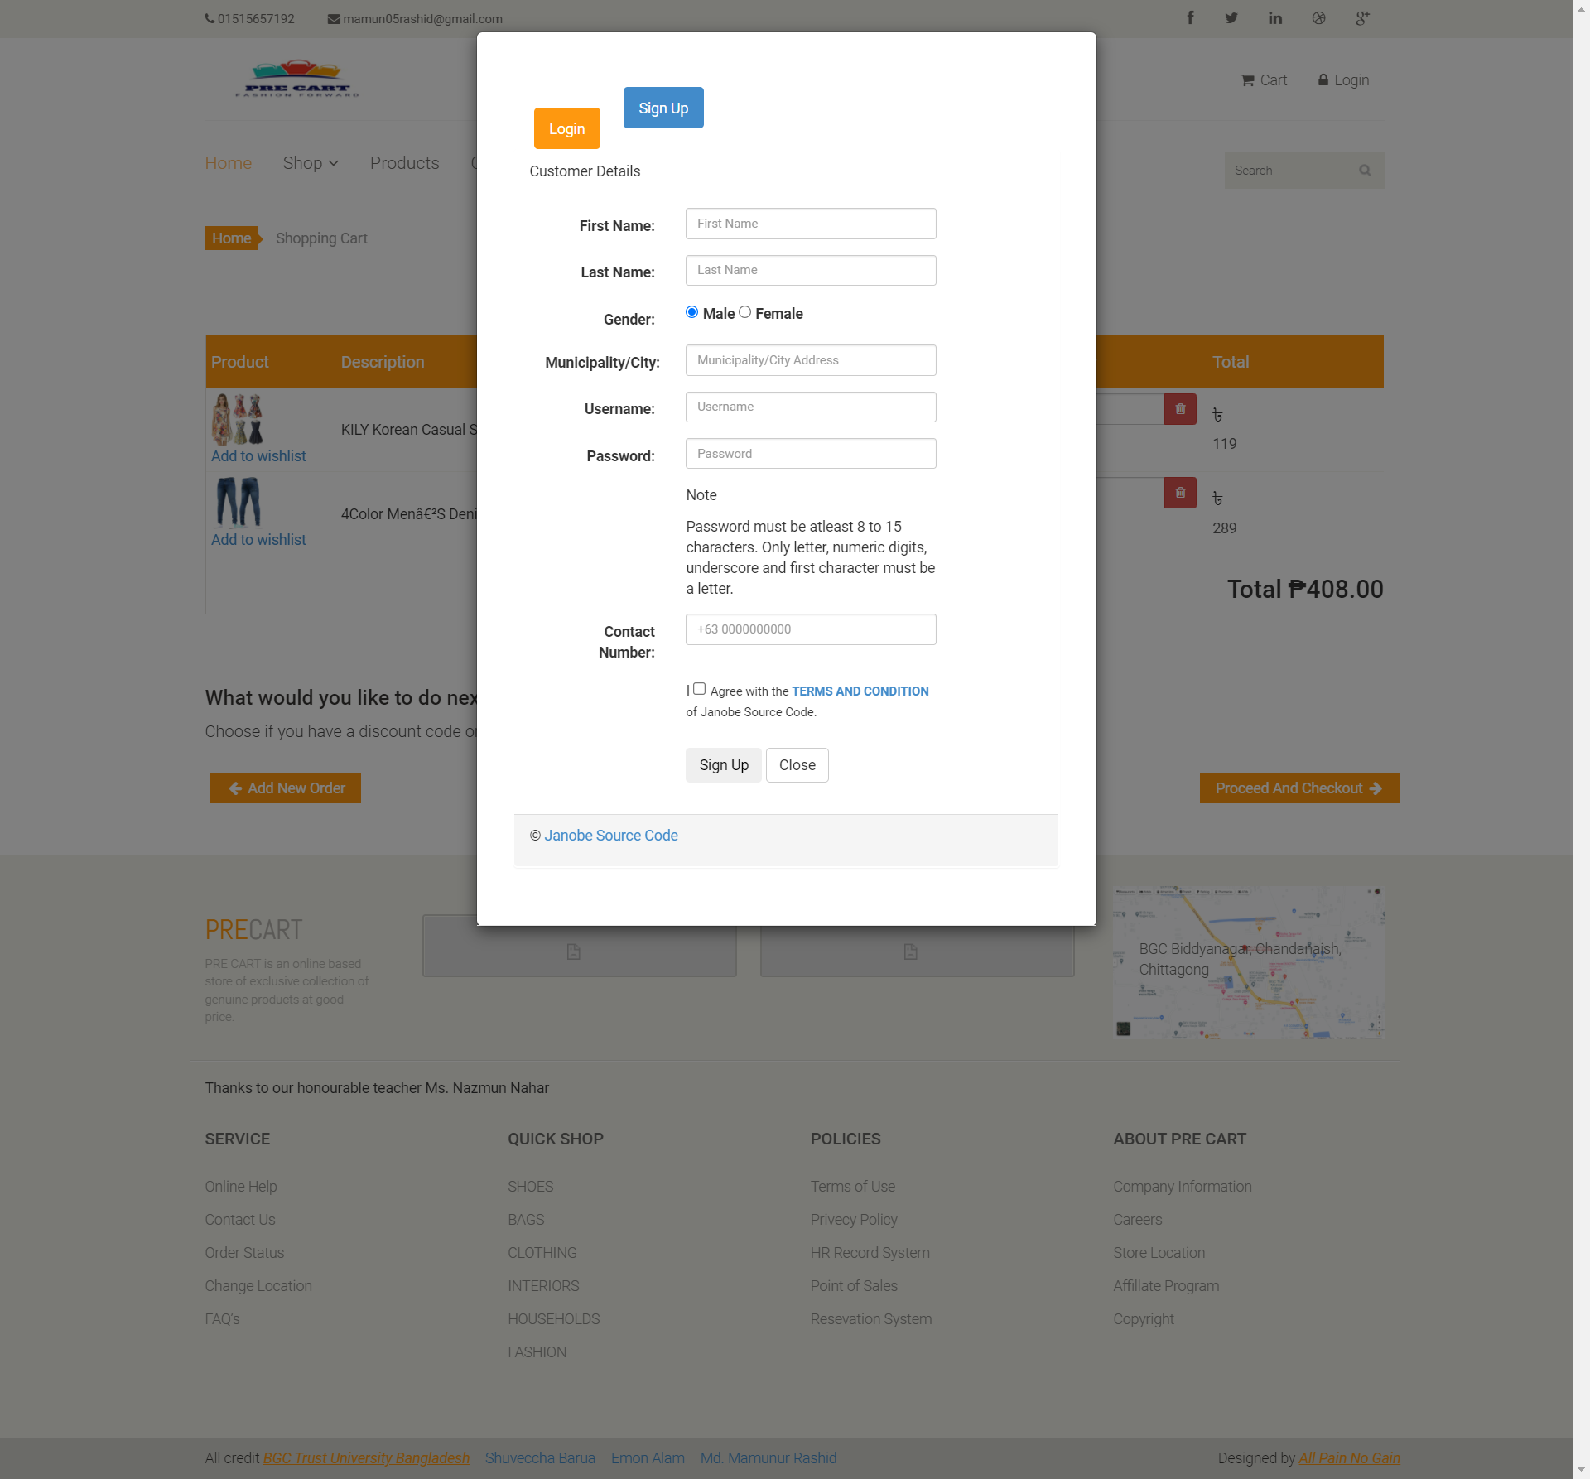

Slide 11
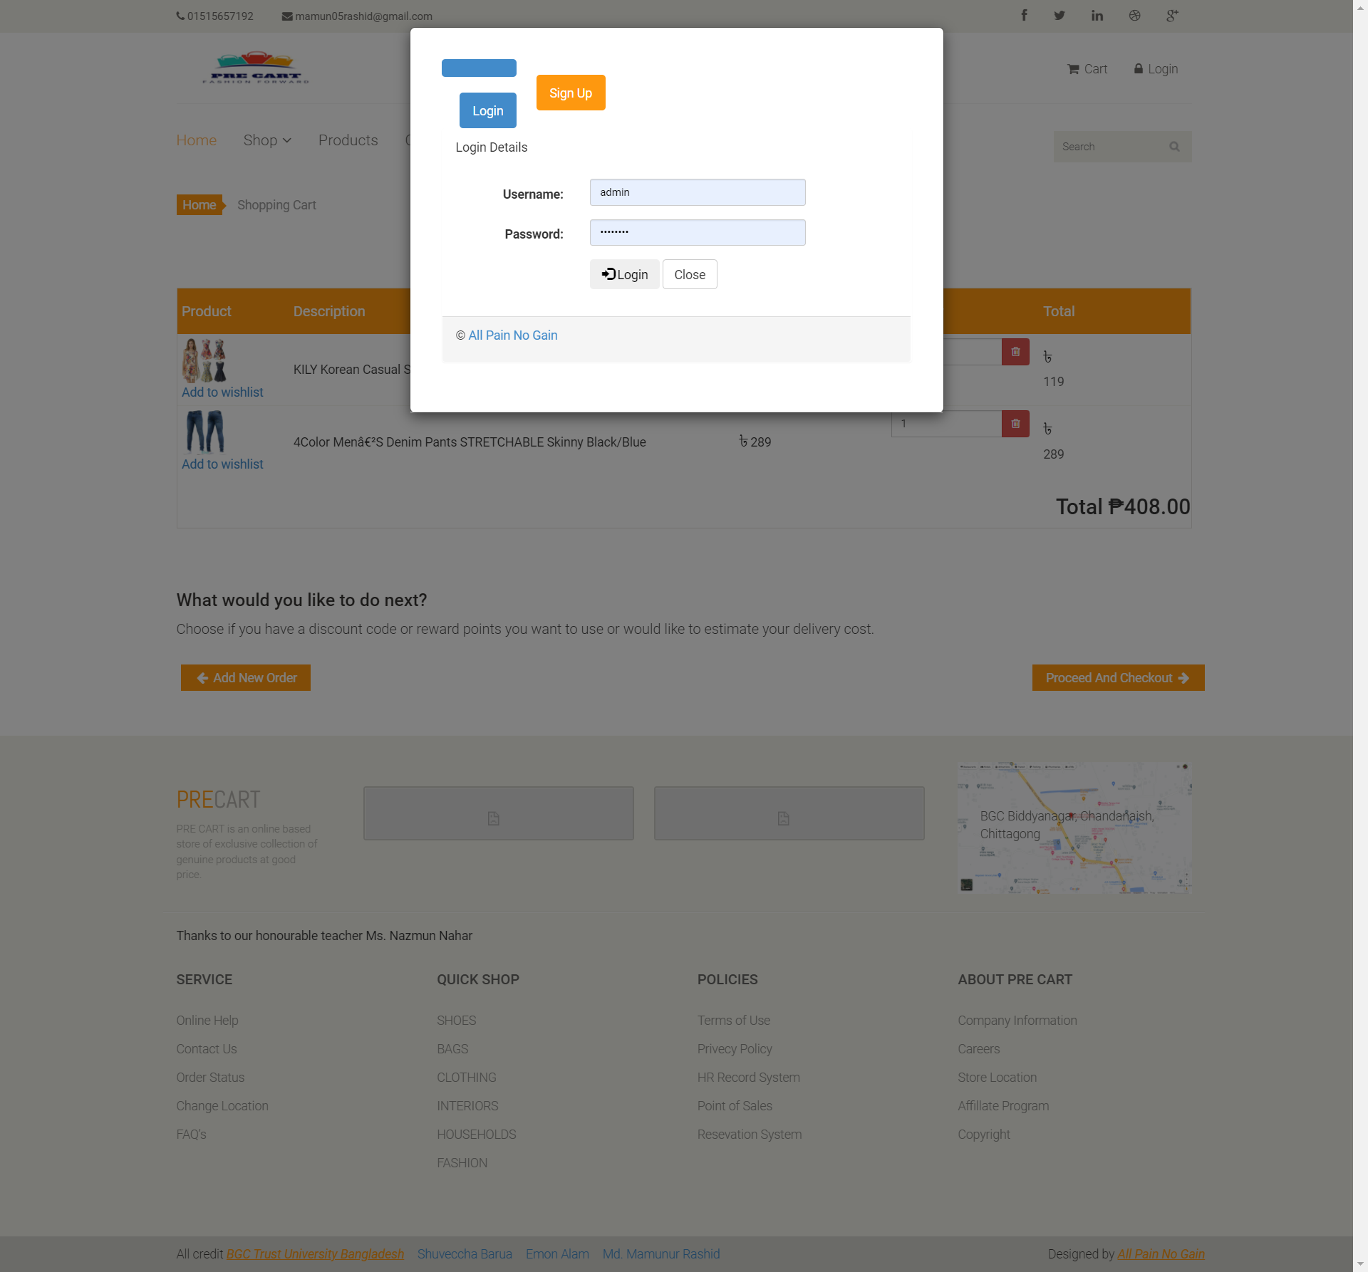

Slide 12
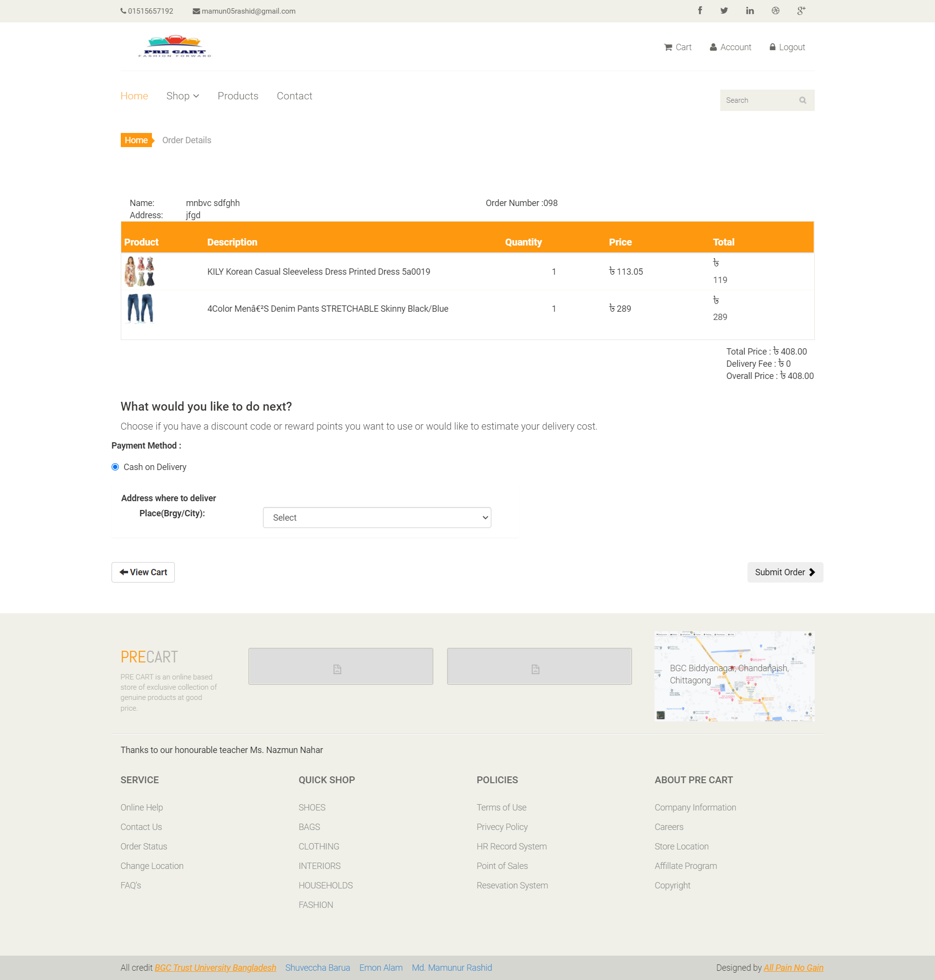

Slide 13
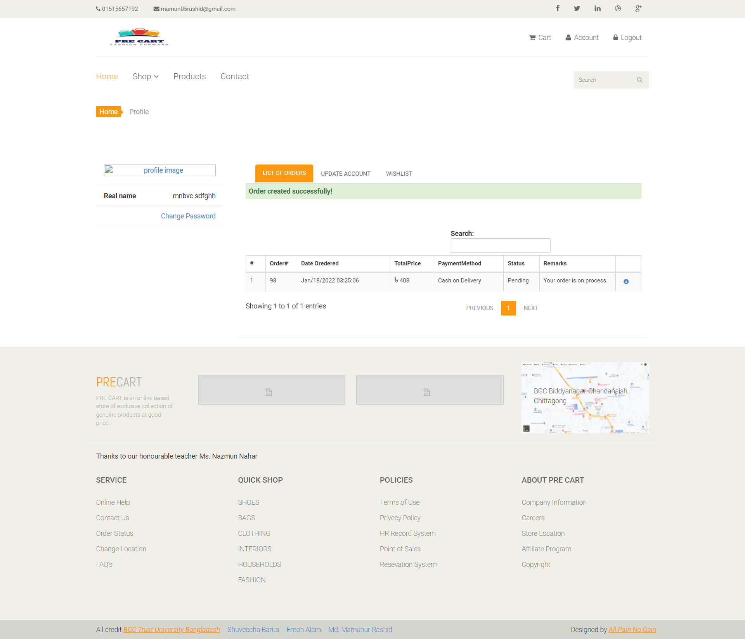

Slide 14


Slide 15
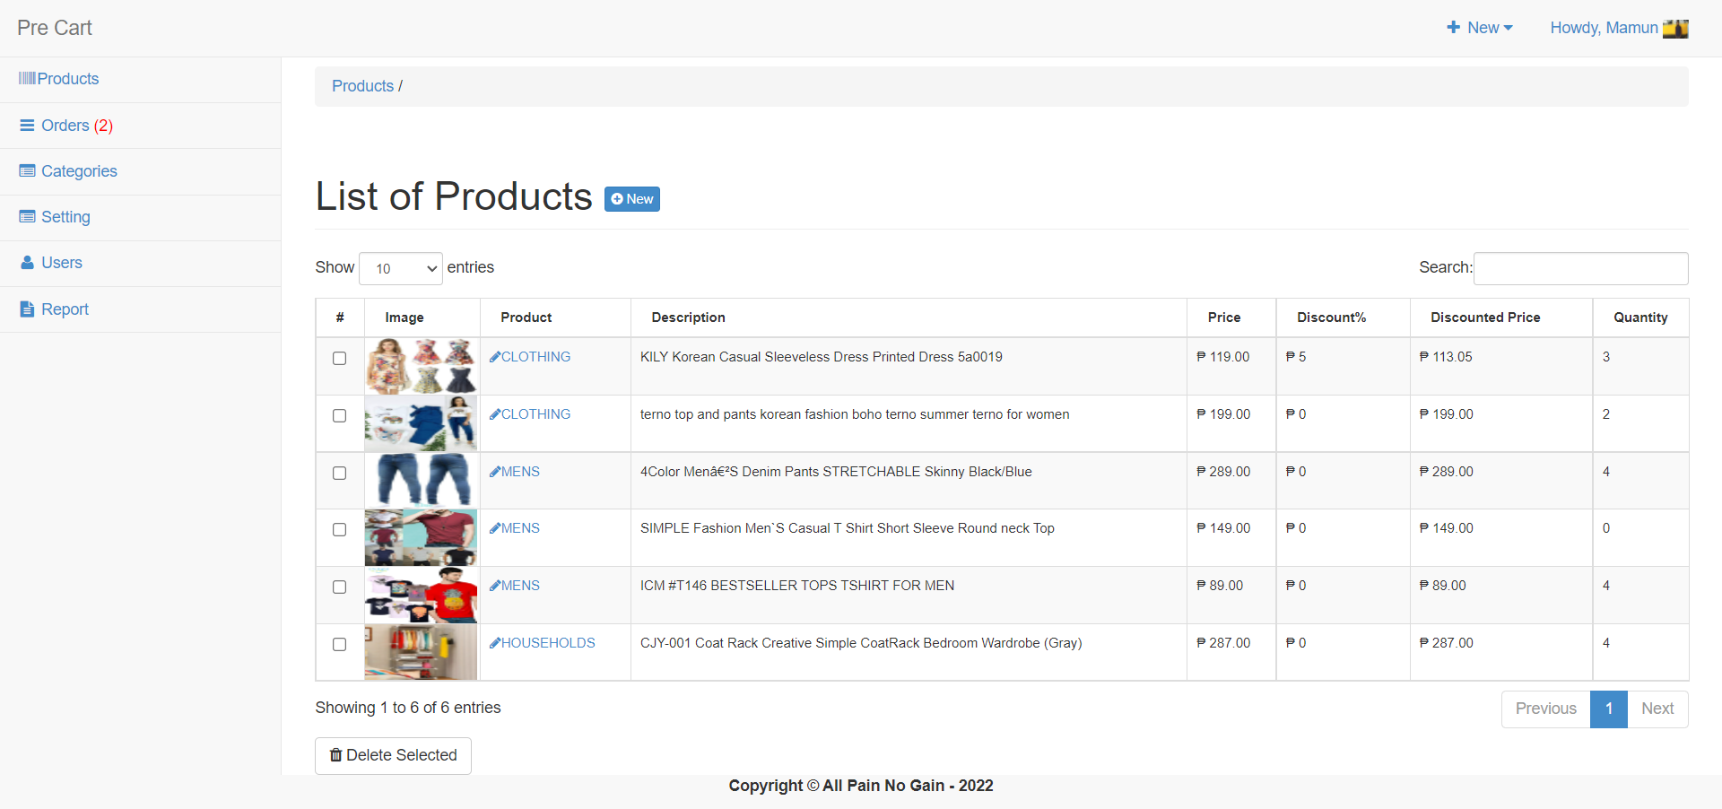

Slide 16
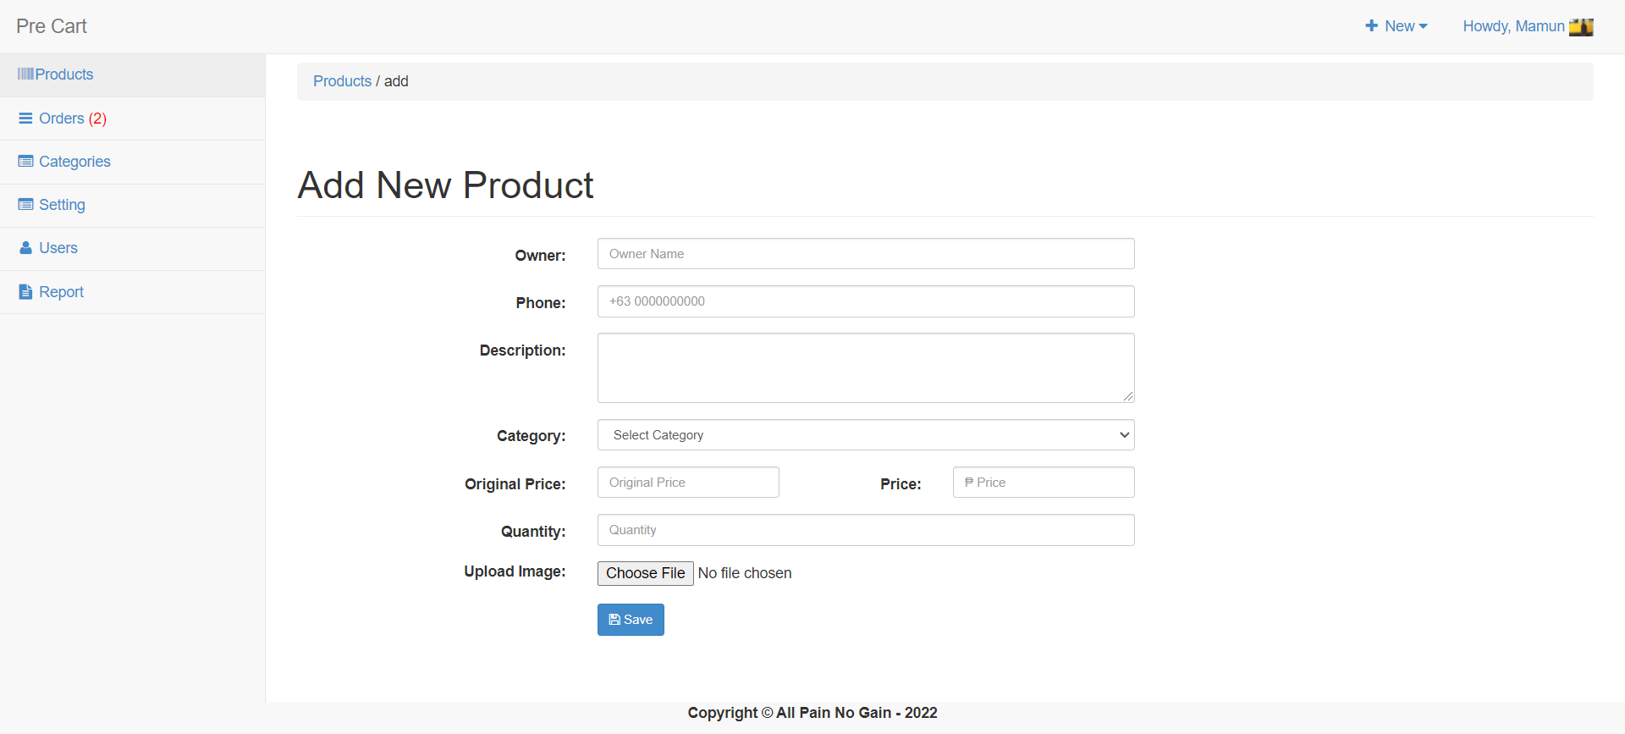

Slide 17
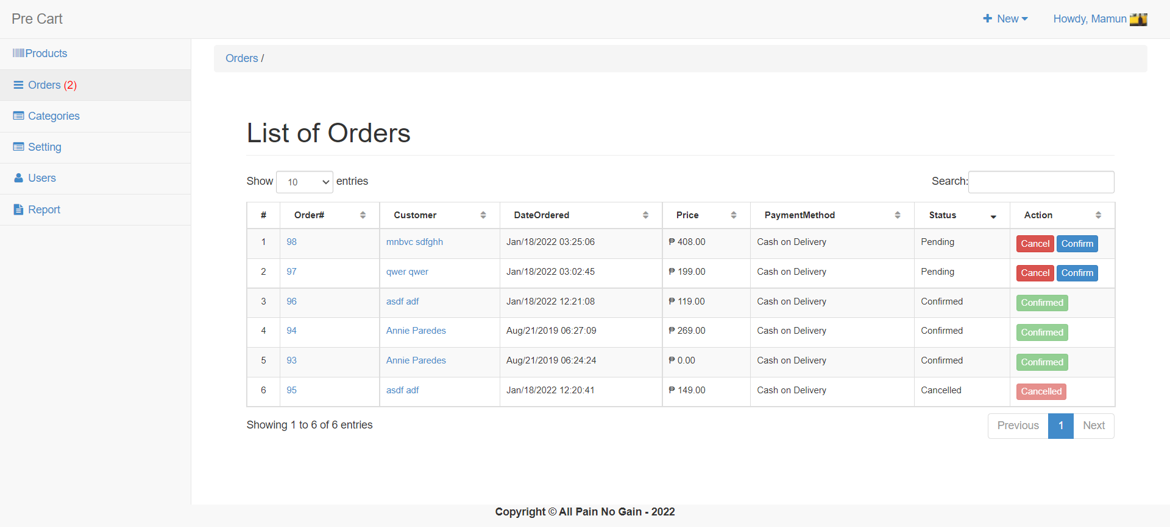

Slide 18
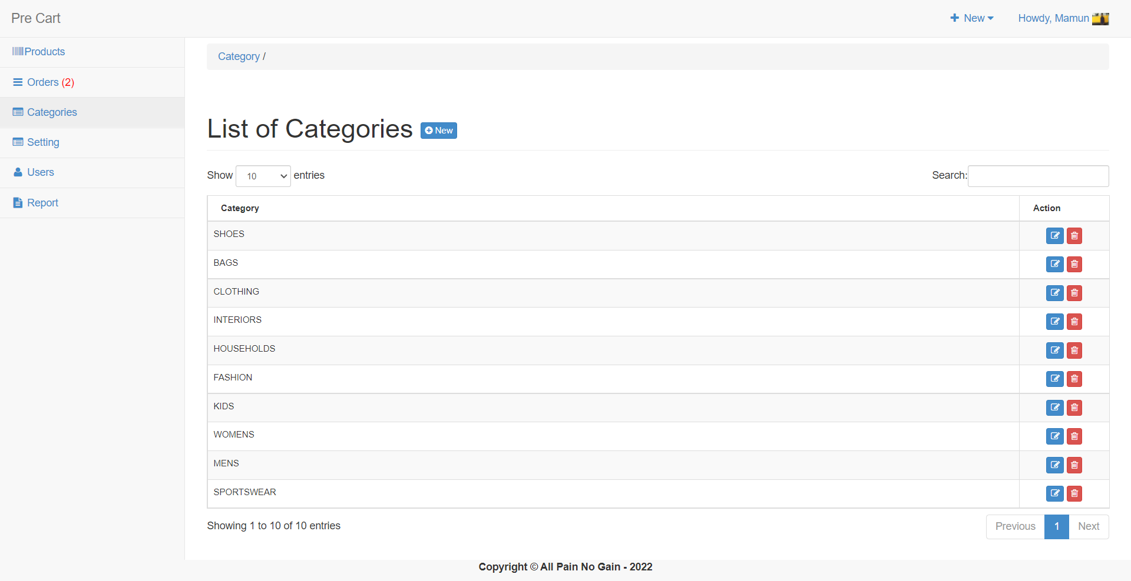

Slide 19
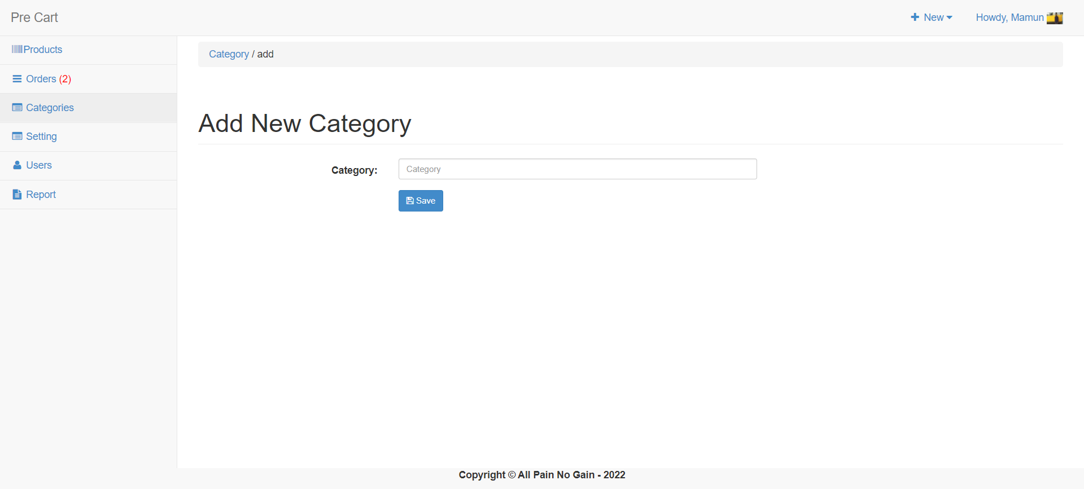

Slide 20
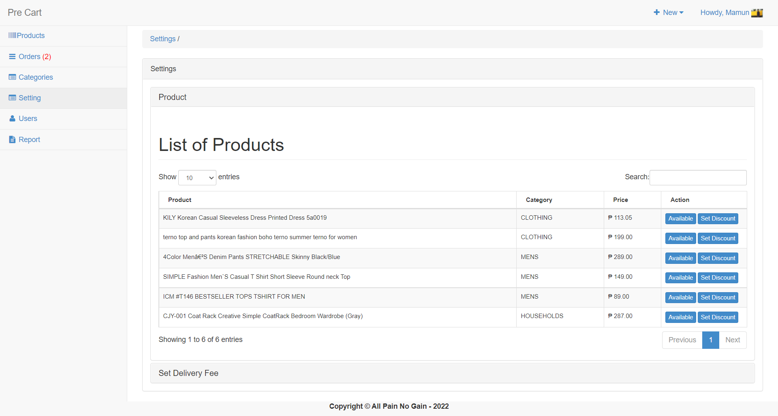

Slide 21
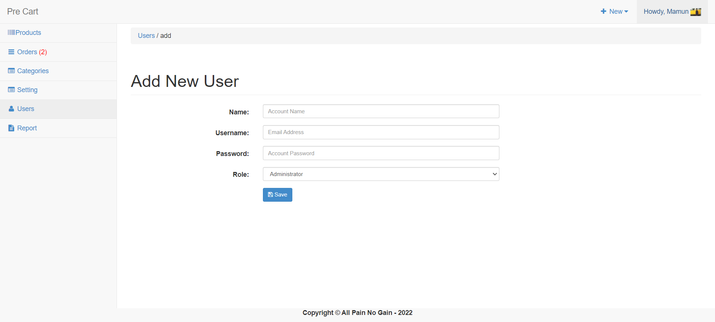

Slide 22
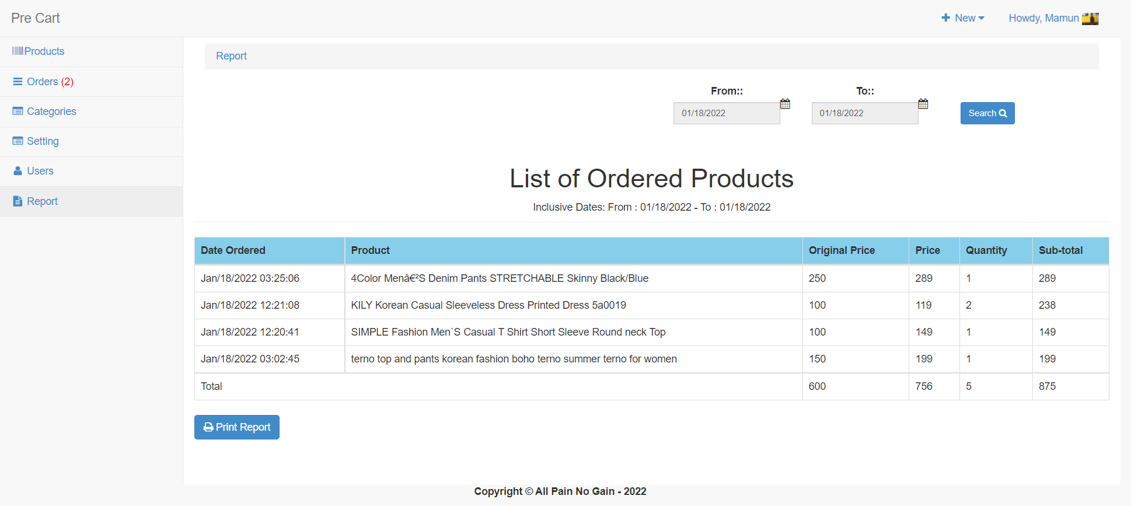

Slide 23
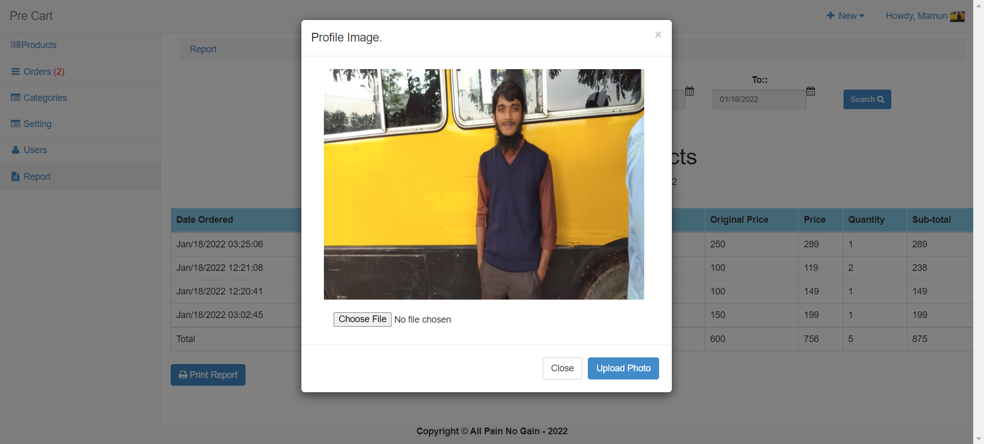

Slide 24
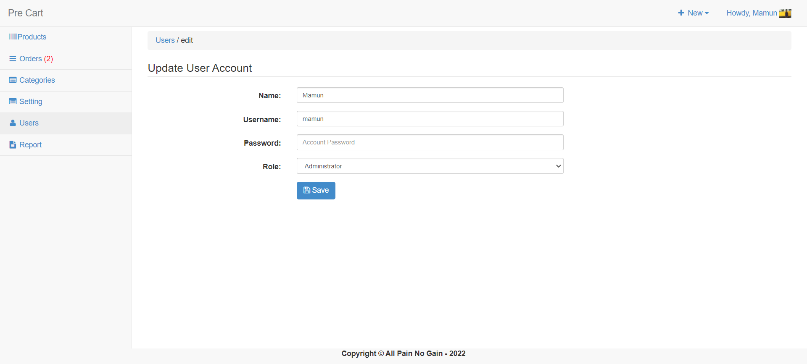

Slide 25
Thank You

